Slide 1

RATIOED NAND AND NOR BASED ON-CHIP PROCESS SENSOR
Authors;
Chandan. M
Prof. Rekha. S. S
Prof. Sudeendra Kumar K

Slide 2


Acknowledgment
I sincerely thank my professors,
Rekha S. S
and
Dr. Sudeendra Kumar K,
for their guidance, support, and valuable contributions by co-authoring this research work.
Authors;
Chandan. M, Department of ECE, PES University.
chandanmchandum2@gmail.com
Prof. Rekha S.S, Associate professor, Dept. of ECE, PES University.
rekha.ss@pes.edu
Dr. Sudeendra Kumar. K, Associate professor, Dept. of ECE, PES University.
sudeendrakumark@pes.edu

Slide 3
Index
What is IC reliability.
What is process variation, why is it important to monitor.
Role of Ring Oscillator as sensors.
Proposed work
Working principle.
Simulations and results
Conclusion.

Slide 4

Introduction
Ever wondered why ICs differ or just vary in their intended performance, despite being manufactured by same fab, sharing same wafer ?
Yes, reliability is of at most concern for yield and quality of ICs.
Some of them cannot be mitigated !!!
Process, Voltage, Temperature (PVT) variations.
Thus, it is very necessary to monitor the environment the IC is experiencing, which would be severe for SoC level IC densities.
Image source: Ruysdael.nl

Slide 5
Process Variation
Process variation, is the variation occurring due to manufacturing processes. This include non-uniform doping concentration, lateral diffusion, etc. Lithographic issues, such as variability in exposure dose and mask defects that result in microscopic deviations in the edges of patterned lines. [1][2]
The effect of process variation is more significant in deep submicron designs, due to technology scaling, which make them more susceptible to variations in process parameters and noise effects like power supply noise, crosstalk reduced supply voltage and threshold voltage operation severely impacting the yield. [3]

Slide 6
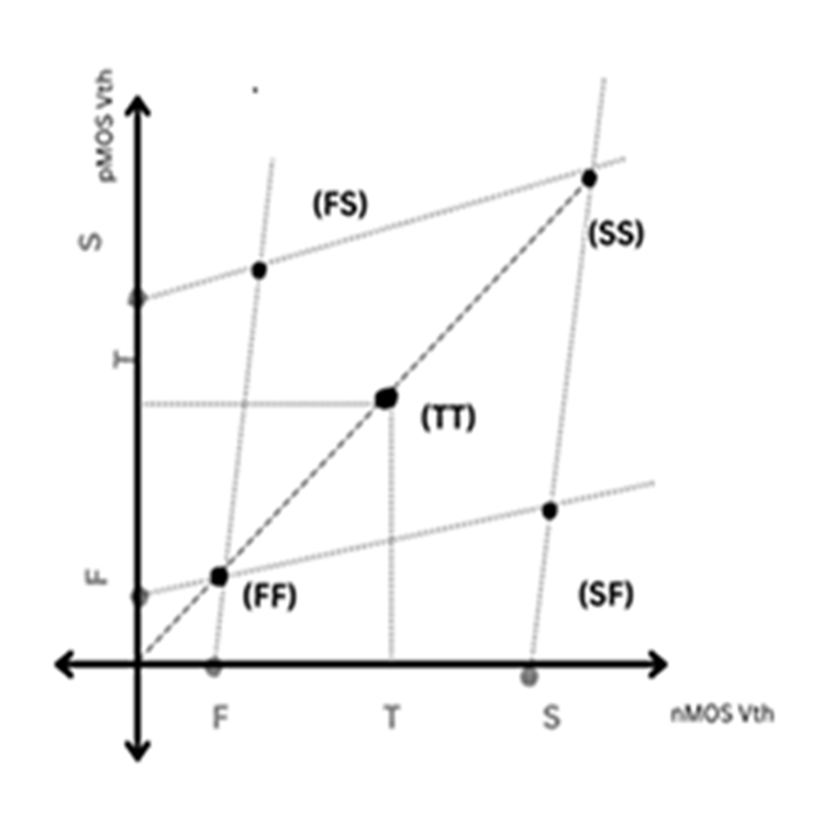
Process Variation
Process variation directly affects threshold voltage (Vth) which plays a crucial role in transistor’s switching activity, thus overall performance (frequency).
Process variations are keyed by process corners, (which helps in binning the IC). Process corners are realized by locus of threshold voltage of nMOS and pMOS.

Slide 7
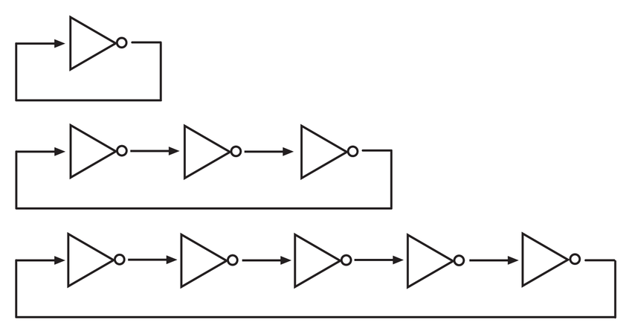
Ring Oscillators
Measuring the process variations on the wafer is generally performed by deploying the Ring Oscillator (RO) circuit on the scribe lines. The On-Chip RO-based process sensors are widely used because their frequency can carry information about variation.! [4][1]
Image source: researchgate.net

Slide 8
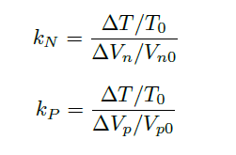
Ring Oscillators
In order to sense the behavior of circuit (MOSFETs to complex circuit), sensing the shift in Vth and thus frequency (1/T) for given temperature is necessary.
The coefficients of the process sensitivity in are the change rate of output period according to the threshold voltage variation and can be expressed as above [5] :

Slide 9
Prior works
Prior works | Prior work | Sensitivity achieved
Heterogenous Structures [5] | Pass-gate logic (N or P) is introduced in between conventional ring oscillator. | Improved sensitivity than CMOS inverters-based RO, but not as significant in terms of sensitivity.
Ratioed- Inverters [1] | Ratioed logic inverters with CMOS inverters are used as delay-cells and hence ring oscillator is made. | Measures better sensitivity than any other RO based Sensors.
Ratioed- Inverters with Reshaper [6] | Only ratioed logic inverter is used for even number of stage and wave reshaper is used as inverting stage in RO. | Measure higher sensitivity than [1] and fails for higher number of stages

Slide 10
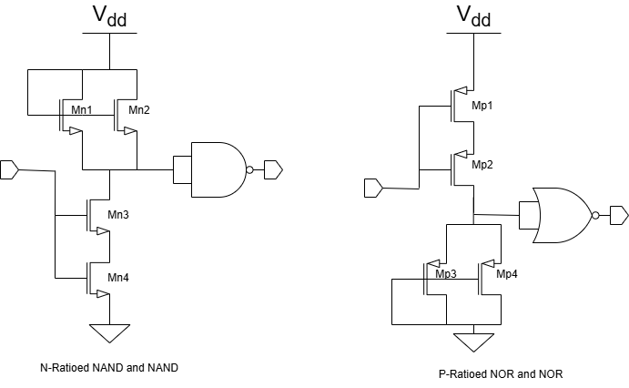
Proposed Work
We propose two delay cell structures to be used in RO circuit to be used as process sensors.
N-Ratioed-NAND delay cell captures variation in nMOS and P-Ratioed-NOR delay cell captures in pMOS.

Slide 11
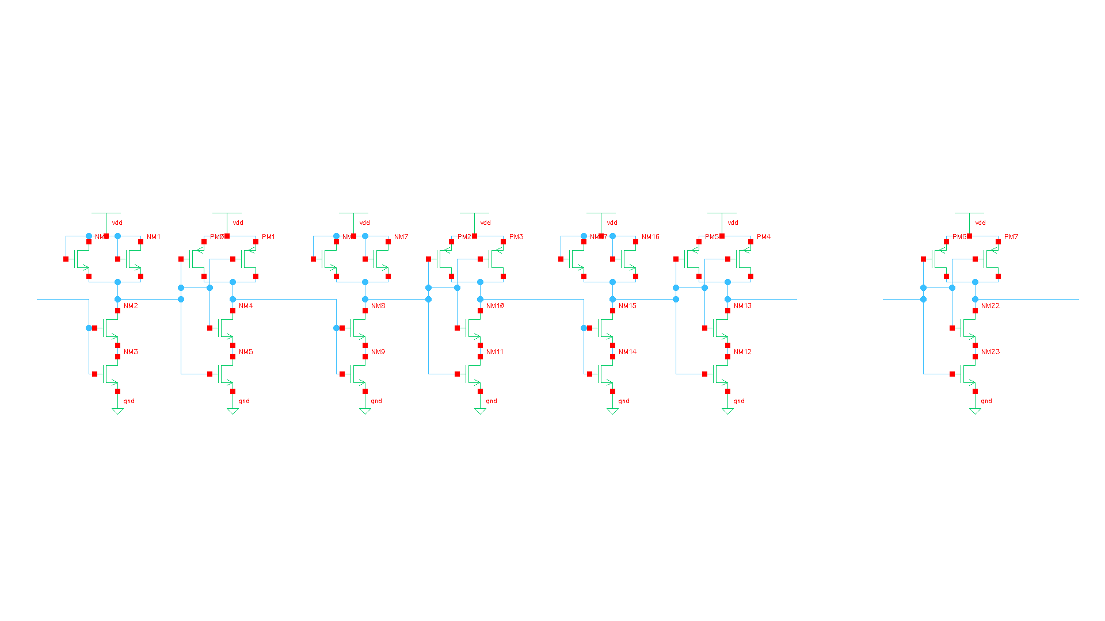
Working Principle
In N-sensitivity, the delay path for logic-0 transition involves only nMOS transistors of all stages. Thus, this delay is more prominent towards change in threshold voltage of nMOS and hence its process variation.
0
0
0
0
0
1
……
Notes:
Initial → 0 , weak 1 by ratioed logic → strong 0 by NAND.
Delay cell is designed.
Delay cell used for even number of stages,
NAND is used as inverting stage.
Logic 0 delay > logic 1 delay.

Slide 12
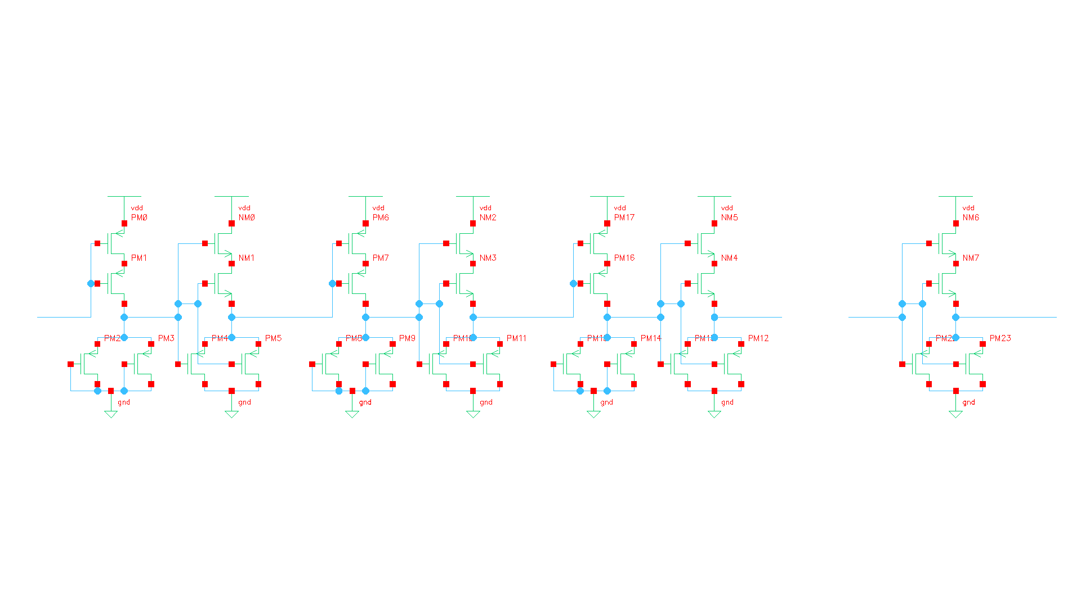
Working Principle
In P-sensitivity, the delay path for logic-1 transition involves only pMOS transistors of all stages. Thus, this delay is more prominent towards change in threshold voltage of pMOS and hence its process variation.
1
1
1
1
1
0
……
Notes:
Initial → 1 , weak 0 by ratioed logic → strong 1 by NOR.
Delay cell is designed.
Delay cell used for even number of stages,
NOR is used as inverting stage.
Logic 1 delay > logic 0 delay.

Slide 13
Simulations & Results
Transients.
Time period of N-delay-cell RO has pulse width of logic-0 is greater than logic-1, which signifies the increased n-sensitivity.
Similarly, time period of P-delay-cell RO shows pulse width of logic-1 is greater than logic-0 indicating its p-sensitivity.

Slide 14
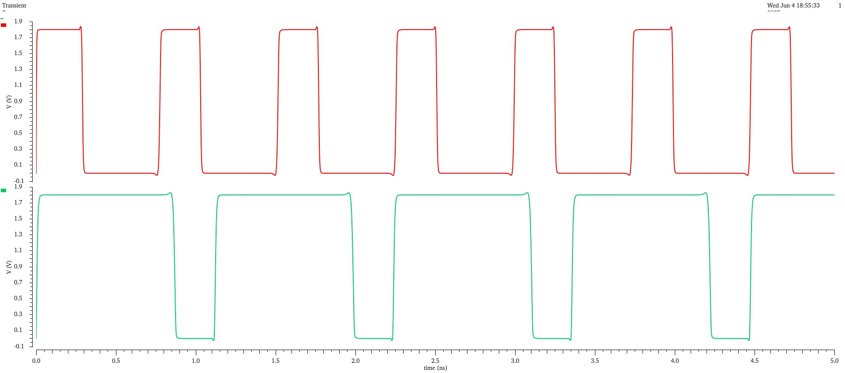
Simulations & Results
Transients.
nMOS
pMOS

Slide 15
Simulations & Results
Frequency analysis.
Using N-delay-cell RO, the order of the frequency plots observed is FF > FS > TT > SS > SF. This is because of the fact that (FF, FS) are corners with fast nMOS, while the (SF, SS) are corners with slow nMOS.
Using P-delay-cell RO, the order of the frequency plots observed is SF > FF > TT > SS > FS. This shows that the (FF, SF) are corners of fast pMOS, while the (FS, SS) are corners of slow pMOS.

Slide 16
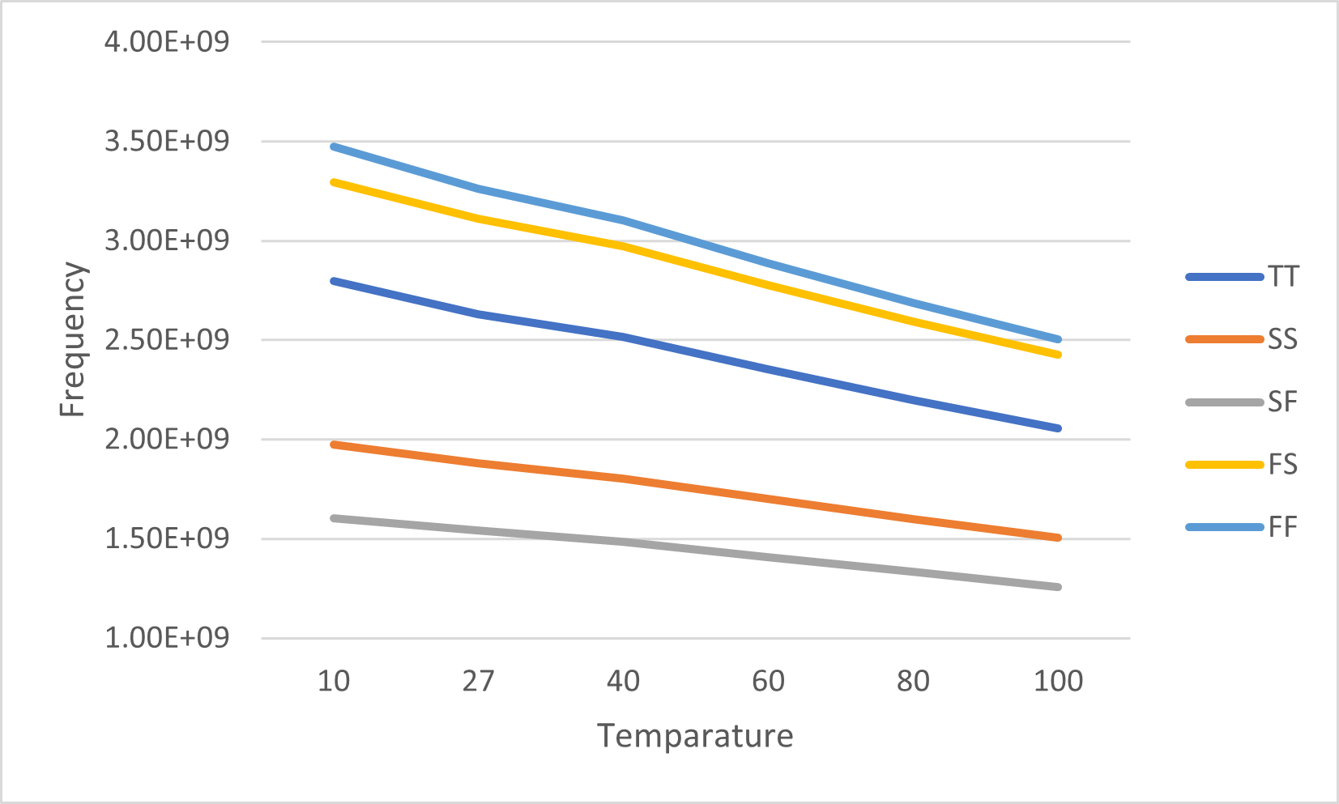
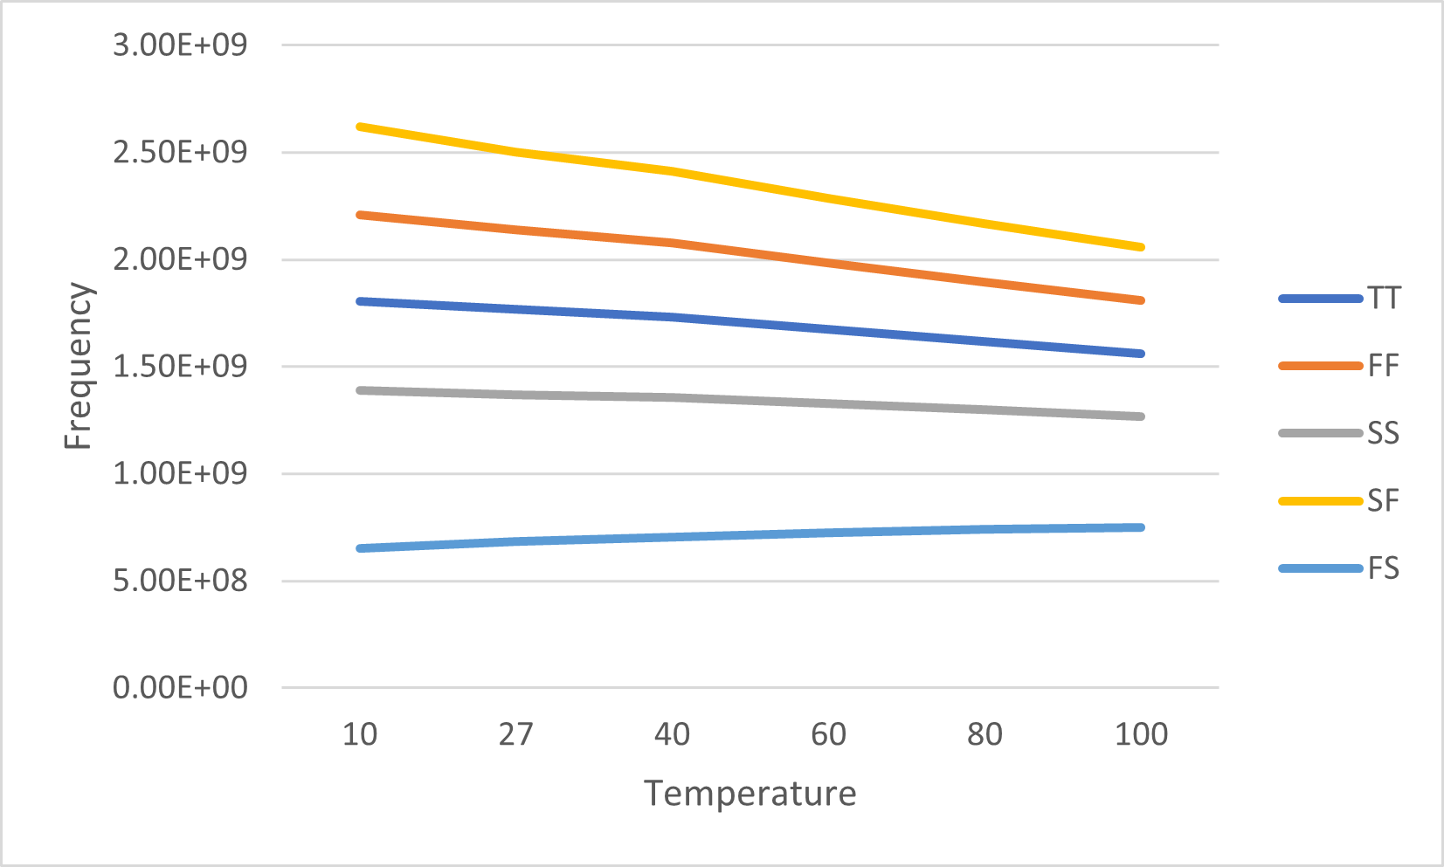
Simulations & Results
Frequency analysis.
N-delay-cell RO frequency
P-delay-cell RO frequency

Slide 17
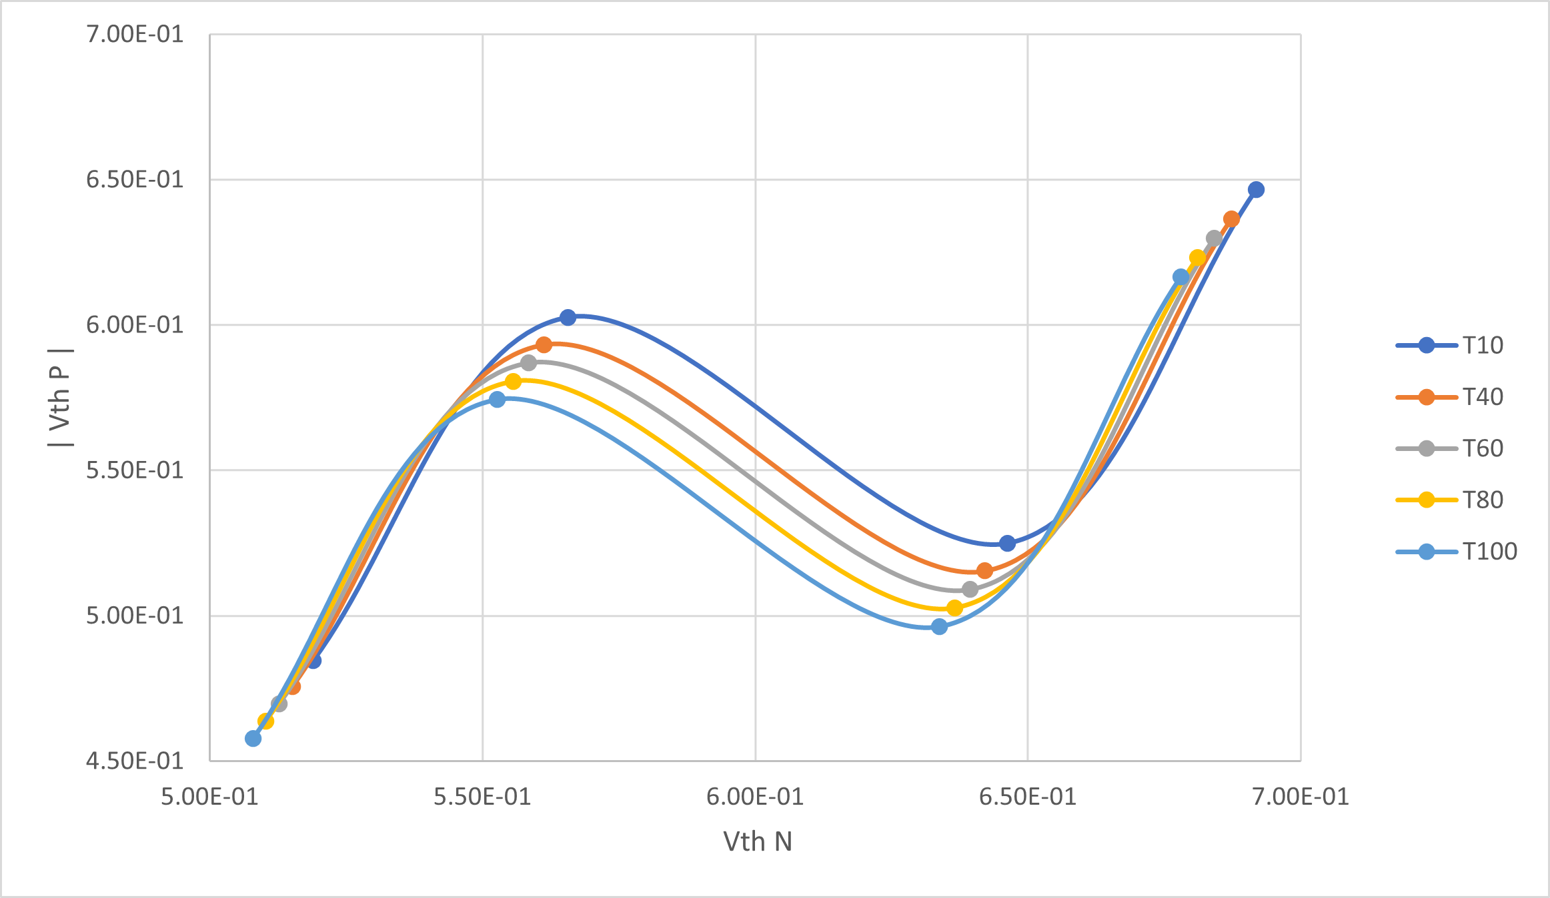
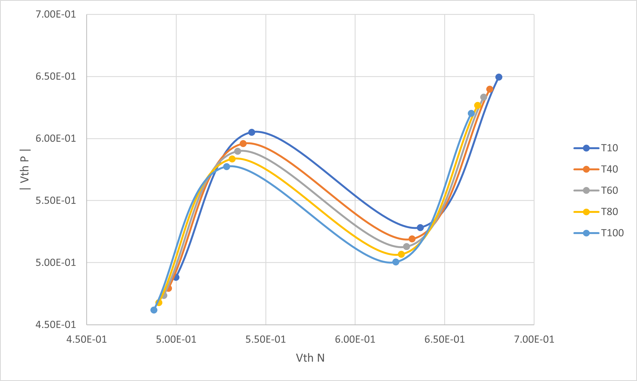
Simulations & Results
Process corner maps.
nMOS process corner
pMOS process corner

Slide 18
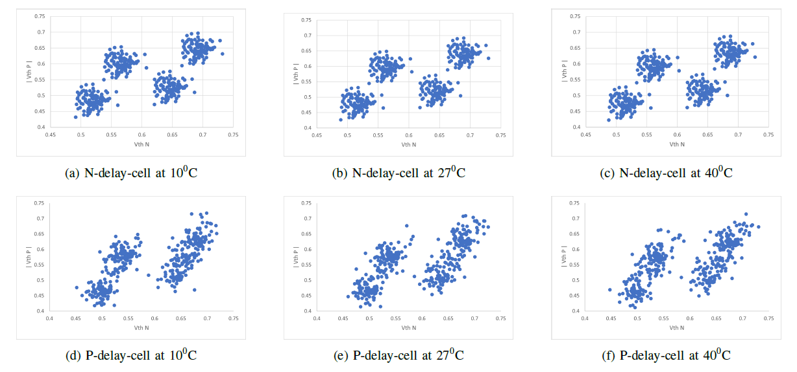
Simulations & Results
Monte-Carlo simulation & Threshold voltage analysis.
The mean threshold voltage of nMOS and pMOS is obtained from the proposed N-delay-cell and P-delay-cell for various temperatures respectively. These values are plotted/fit into the process corner map.

Slide 19
Simulations & Results
Sensitivity comparison.
Design | N Sensitivity | P Sensitivity | Power (mW)
Heterogeneous structures [5] | 0.865 | 1.335 | 0.291
Ratioed Inverters[1] | 1.934 | 3.189 | 3.288
Proposed Design | 4.086 | 7.223 | 2.902

Slide 20
Conclusion
The proposed process sensor has got a sensitivity that is more than 100% of the work presented in [1] and more than 300% the sensor presented in [5].
The process corner cluster are almost stable to temperature variation and while using 12% less power. However, this improvement comes at the expense of compromising the chip-area.

Slide 21
References
[1]. Y. -J. An, D. -H. Jung, K. Ryu, H. S. Yim and S. -O. Jung, "All-Digital ON-Chip Process Sensor Using Ratioed Inverter-Based Ring Oscillator," in IEEE Transactions on Very Large Scale Integration (VLSI) Systems, vol. 24, no. 11, pp. 3232-3242, Nov. 2016, doi: 10.1109/TVLSI.2016.2550603.
[2]. Kavita Sharma, PVT (Process, Voltage, Temperature), physicaldesign4u.com [Online].
[3]. A. Zjajo, M. J. Barragan and J. P. de Gyvez, "Low-Power Die-Level Process Variation and Temperature Monitors for Yield Analysis and Optimization in Deep-Submicron CMOS," in IEEE Transactions on Instrumentation and Measurement, vol. 61, no. 8, pp. 2212-2221, Aug. 2012, doi: 10.1109/TIM.2012.2184195.
[4]. M. Bhushan, A. Gattiker, M. B. Ketchen and K. K. Das, "Ring oscillators for CMOS process tuning and variability control," in IEEE Transactions on Semiconductor Manufacturing, vol. 19, no. 1, pp. 10-18, Feb. 2006, doi: 10.1109/TSM.2005.863244.
[5]. S. Fujimoto, A. K. M. M. Islam, T. Matsumoto and H. Onodera, "Inhomogeneous Ring Oscillator for Within-Die Variability and RTN Characterization," in IEEE Transactions on Semiconductor Manufacturing, vol. 26, no. 3, pp. 296-305, Aug. 2013, doi: 10.1109/TSM.2013.2265702.
[6]. V. Lidholm, ‘Fully Digital Process Variation Sensor for High Performance System-on-a-Chip’, Dissertation, 2022 [link].

Slide 22
Thank You

